Slide 1
BIO-DIVERSITY
Biodiversity is the variety and differences among living organisms from all sources, including terrestrial, marine, and other aquatic ecosystems and the ecological complexes of which they are a part.
It is virtually synonymous with “Life on earth”.
The biodiversity found on Earth today consists of many millions of distinct biological species, which is the product of nearly 3.5 billion years of evolution.

Slide 2
Definition: Biodiversity deals with the degree of nature’s variety in the biosphere (Life on Earth). Biologists most often define “Biodiversity” as the “Totality of genes, species and ecosystems of a region”.
Biodiversity is the variety and difference in genes among the individuals of a species, the variety and richness of all the plant and animal species at different scales in space in a region, in the country and the world and the types of ecosystem both terrestrial and aquatic within a definite area.
Nearly 3.5 billion years of evolution has produced millions of distinct biological species on Earth today.

Slide 3
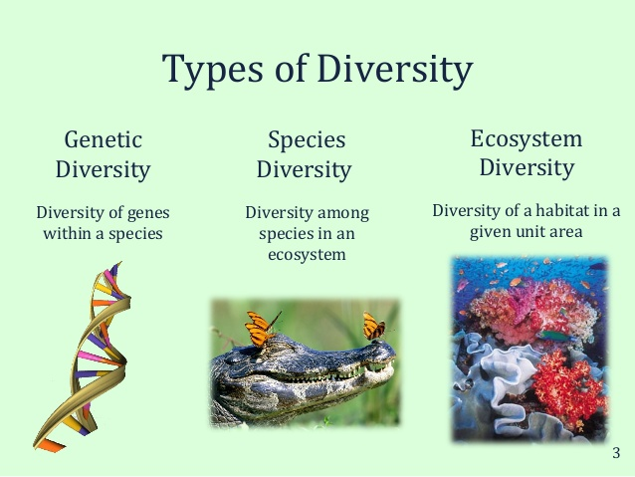
Levels of Biodiversity

Slide 4
Genetic Diversity
Genetic diversity is defined as genetic variability present within species. Genetic diversity is the product of recombination of genetic material in the process of inheritance. It changes with time and space.
Sexual reproduction is important in maintaining genetic diversity as it gives unique offspring by combining genes of parents.
Mutation of genes, genetic drift and gene flow are also responsible for genetic diversity.

Slide 5
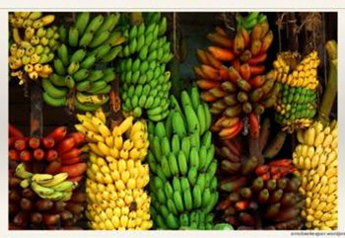
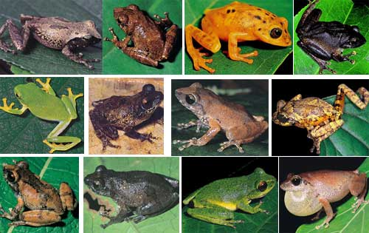
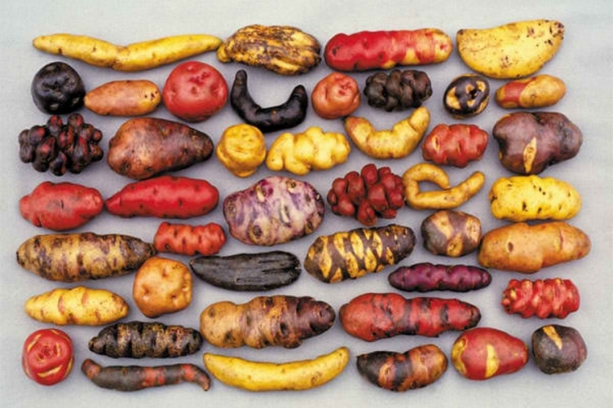


Slide 6
Species Diversity
Species diversity is defined as the number of different species present in an ecosystem and relative abundance of each of those species.
It has much more useful value then species richness.
At present, conservation scientists have been able to identify and categorize about 1.8 million species on Earth.
India is among the world’s 15 Nations that are exceptionally rich in species diversity.

Slide 7
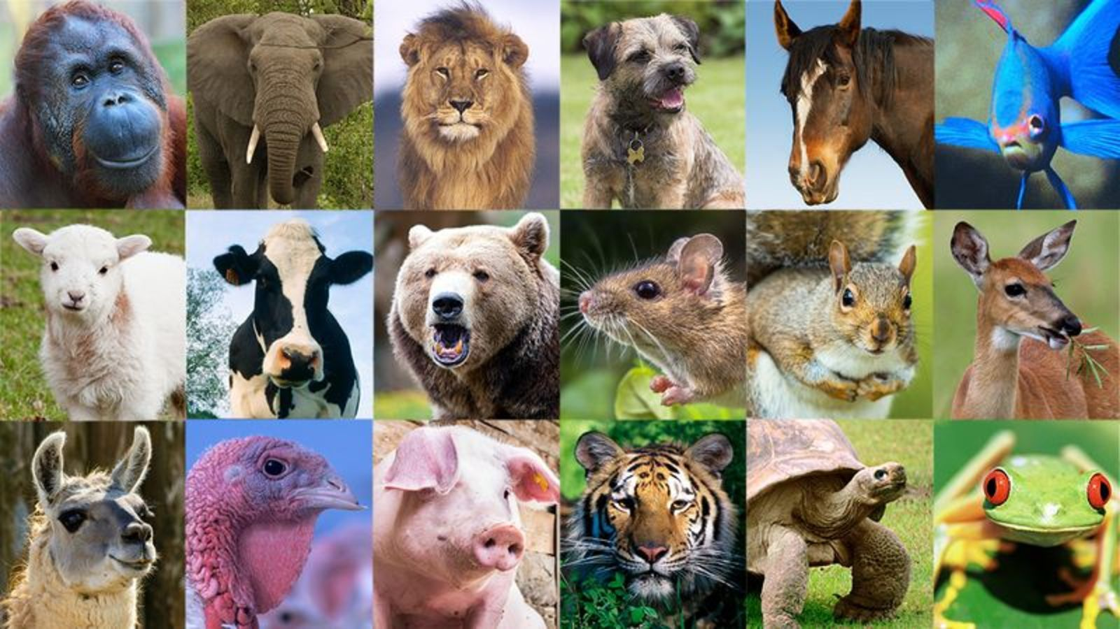

Slide 8
Ecosystem Diversity
Ecosystem diversity deals with the variations in ecosystems within a geographical location and its overall impact on human existence and the environment.
Ecological diversity is the largest scale of biodiversity, and within each ecosystem, there is a great deal of both species and genetic diversity.

Slide 9
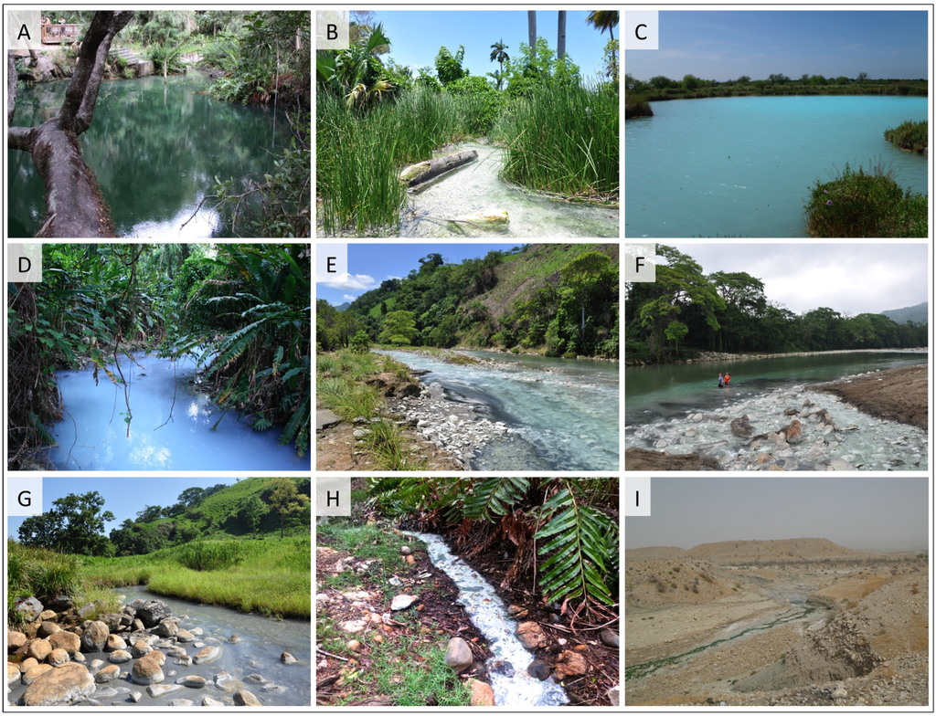

Slide 10
Values of Biodiversity
Direct values (Consumptive uses)
Timber, food, fuel wood, fodder, medicines for local community –forest ecosystem.
Fish, other edible aquatic plants and animals – Marine resources.
2. Productive use value:
Production of marketable goods
Biotechnologist – Better varieties of crops.
Pharmacist – New and better drugs/medicines
Industrialists – new products
Agricultural Scientists – Developing new crops
Plant Genetics – Better crops with plant breeding
Biological prospecting – New medicines from wild species of plants.

Slide 11
3. Social Values:
Preserved as valuable resource many sacred and holy plants like- Tulsi, Peepal, and animals like Cow.
4. Ethical and Moral values: Ethical responsibility to protect all life forms.
Preservation of nature through local traditions.
Conservation of biodiversity & economic importance.
5. Aesthetic Values: Preservation of its inherent value, beauty, aesthetics and creativity for tourist attraction.
Indian mythology eulogies animals like elephant, snake and cow.
Plants like Tulsi, Peepal.
6. Option Value: Keeping future possibilities open for their use is called the option value.
The preservation of biodiversity must also include traditionally used strains already in existence in crops and domestic animals.

Slide 12
Biogeographic Classification of India
India is divided in to ten major regions based on geography, climate, vegetation pattern, mammals, birds, reptiles, amphibians, insects and other invertebrates that live in them.
The cold mountainous snow covered Trans-Himalayan region of Ladakh.
The Himalayan ranges and Kashmir valley, Himachal Pradesh, Uttarkhand, Assam and other North-eastern states.
The Thar desert of Rajasthan
The semi-arid grassland region of Gujurat, Madhya Pradesh
The Western Ghats in Maharashtra, Karnataka and Kerala.

Slide 13
6. Deccan plateau of Chattisgarh, Andhra Pradesh, Karnataka. The North-eastern states of India.
The Gangetic plain of Bihar, West Bengal
The long western and eastern coastal belt with sandy beaches, forests and mangroves.
The North-East region of Manipur, Nagaland
The Andaman and Nicobar Island.

Slide 14
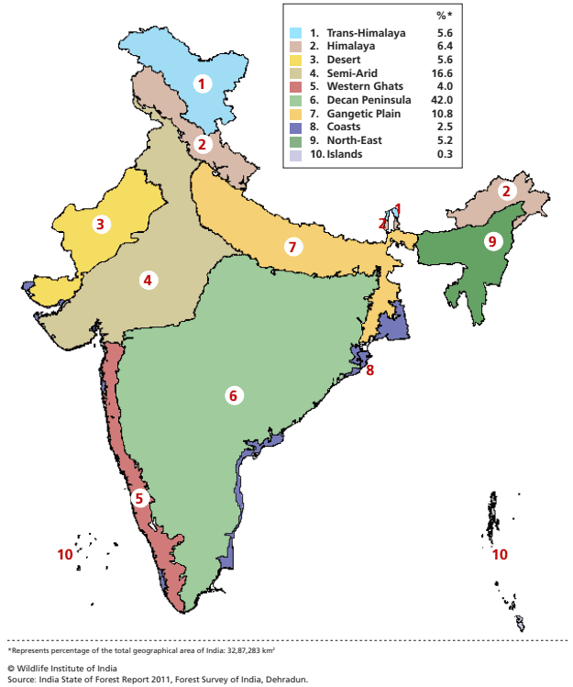
Biogeographic Zones of India

Slide 15
THREATS TO BIODIVERSITY
There are different threats to biodiversity because of which their population is going on decreasing day by day. The threats may be natural on anthropogenic. Some of the causes are discussed below;
1. HABITAT LOSS, DEGRADATION, FRAGMENTATION.
Habitat loss & degradation are major causes of species extinction, affecting 89% of all threatened birds, 83% of mammals & 91% of all threatened plants assessed globally (IUCN, 2000).
The main causes of habitat loss are agriculture activities, mining, large hydro power plants, development of human settlement area and industry etc.
2. POACHING OF WILDLIFE
Poaching is another threat that has emerged in recent decades as one of the primary reason for decline in number of species.
Wildlife is sold and traded in many countries for live specimens, folk medicines, furs, skin, and other products such as Ivory, horns etc amounting to millions of dollars.

Slide 16
3. MAN – WILDLIFE CONFLICTS
Due to the lack of stable food and disruption of movement, wild animals came out of forest area and attack the agricultural field and humans and in turn got killed by the humans.
4. INTRODUCTION OF EXOTIC SPECIES
Organisms introduced into new habitats where they are not native are termed as exotics are also considered as Biological Pollutants.
5. CLIMATE CHANGE AND ENVIRONMENTAL POLLUTION
A changing global climate threatens species and ecosystems.
The air, water and soil pollution are the major factor to extinct number of species in both terrestrial and aquatic ecosystems.

Slide 17
Biodiversity at Global, National and Local Levels
1.8 million known species have been documented. Estimated number of species of plants and animals could be 15-20billion, that means majority of species are yet to be discovered.
If biodiversity should form the ‘common property resource’, to be shared by all nations, there is no reason to exclude oil, uranium or even intellectual and technological expertise as global assets.

Slide 18
World Heritage sites include: Manas Sanctuary at India- Bhutan Boarder
Kaziranga in Assam
Bharatpur in UP
Nandadevi in the Himalayas
Sunderbans in West Bengal
India has signed the Convention in the Trade of Endangered Species (CITES), to reduce the utilization of endangered plants and animals.

Slide 19
MOEF is the nodal agency for implementation of CBD in India.
National Biodiversity Action Plan (NBAP) was formulated in 2000
India as a mega-diversity nation
India is among the top 10-15 countries with high biodiversity.
It is10th among the plant rich countries of the world and 4th among the Asian countries.
350 mammal species – 8th in the world
1200 bird species – 8th in the world
453 reptile species -5th in the world
45,000 plant species – 15th in the world

Slide 20
18% Indian plants are endemic to the country and found nowhere in the world
62% amphibians are endemic
50% of the lizards are endemic
Gene banks have collected - 34,000 cereals
- 22,000 pulses
- 27 breeds of cattle
- 40 breeds of sheep
- 22 breeds of goat
- 8 breeds of buffalos
Many of these are dying out due to misguided adoption of all foreign things.

Slide 21
ENDANGERED AND ENDEMIC SPECIES IN INDIA
According to The International Union of Conservation of Nature and Natural Resources (IUCN), the species that considered in imminent danger of extinction and whose survival is unlikely, if factors causing their decline continue to operate.
Out of about 47,000 species of plants in our country, 7000 are endemic.
In India, 53 species of mammals, 69 birds, 23 reptiles and 3 amphibians are considered as threatened species.
As many as 3,000- 4,000 higher plants may be under high degree of threat in India.

Slide 22
Red Data Book of IUCN( International Union for Conservation of Nature and Natural Resources, 1964)
Classification of plant and animal as per Red Data Book
Endangered (E)
Vulnerable (V)
Rare (R)
Threatened (T)
Out of danger (O)
Indeterminate (I)

Slide 23
Endangered (E)
Species whose numbers have been reduced to a critical level or whose habitats have been so drastically reduced that they are deemed to be in immediate danger of extinction.
Vulnerable (V)
Species believed likely to move into the endangered category in the near future if the casual factors continue operating.
Rare (R)
Species with, small world populations that are not at present endangered or vulnerable, but are at risk.
Threatened (T)
Threatened is used in the conservation context for species which are in one of the categories Endangered, Vulnerable and Rare.
Out of danger (O)
Species formerly included in one of the above categories, but which are now considered relatively secure because effective conservation measures have been taken
Inderterminate (I)
Species that are suspected of belonging to one of the first three categories, but for which insufficient information is currently available.

Slide 24
CONSERVATION OF BIODIVERSITY
The convention on Biological Diversity held in June, 1992 stressed the need of the conservation of Biodiversity for sustainable development.
Conservation is defined as “the management of human use of the biosphere so that it may yield the greatest sustainable benefit to the present generation while maintaining its potential to meet the needs and aspirations of the future generations”.
The two basic approaches to wildlife conservation in protected habitats are:
1) In- Situ conservation 2) Ex- Situ conservation.

Slide 25
In- Situ conservation
It simply means conservation of species in its natural ecosystem or habitat through a network of “protected area”.
Protected Areas: an area of land and/or sea specially dedicated to the protection and maintenance of biological diversity and managed through legal effective means.
These include:-
Biosphere reserves
National parks
Wild Life Sanctuaries etc.

Slide 26
Biosphere Reserves have been described as undisturbed natural areas for scientific study as well as areas in which conditions of disturbance are under control. These serve as the centre for ecological research and habitat protection, The "Biosphere Reserve consists of two main zones as:
Core zone (undisturbed area)
2. Buffer zone( open for tourism)
Indian Government has established 18 Biosphere Reserves. The main objectives of the programme are as follows:
• Conserve biological diversity
• Safeguard genetic diversity
• Provide areas for basic and applied research
• Opportunity for Environmental Science and training
• Promote international cooperation
• Promote management of biotic resources.
Biosphere

Slide 27
National Park
According to the Indian Board for Wild Life (IBWL), “A National Park is an area dedicated by statute for all time to conserve the natural scenery and historical objects to conserve the wild life there in and to provide for enjoyment of the same in such manner and by such means, that will leave them undisturbed for the enjoyment of future generations .
India’s first national park was established in 1936 as Hailey National Park, now known as Jim Corbett natioal Park.
In 1972, India enacted the Wildlife Protection Act and Project Tiger to Safeguard the habitats of conservation reliant species.

Slide 28
Examples of some National park in India
Kaziranga- Assam,
Gir National Park- Gujarat
Periyar – Kerala
Sariska – Rajasthan

Slide 29
Wildlife sanctuary
The Indian Board for Wild Life has defined a sanctuary as, 'An area where killing, hunting, shooting or capturing of any species of bird or animal is prohibited except by or under the control of highest authority in the department responsible for the management of the sanctuary and whose boundaries and character should be sacrosanct as far as possible.
Examples of some Wild Life Sanctuaries of India:
Ghana Bird sanctuaries
Hazaribagh sanctuaries
Abohar wild life sanctuaries
Jaldapara wild life sanctuaries
Mudamalai wild life sanctuaries

Slide 30
Ex- Situ conservation
It is defined as “the conservation of component of biological diversity (Sample of genetic diversity, particularly of endangered species) outside their natural habitats”.
Botanical/ zoological gardens, aquarium and research centre.
There are more than 1500 Botanical gardens in the world containing more than 80,000 species. There are more than 800 zoos around the world with about 3,000 species of mammals, birds, reptiles and amphibians.
Field Gene Banks
These are places where wide variety of plant are growing in order to maintain the widest range of biodiversity.
Seed Banks
These are most efficient and effective method of Ex-Situ conservation of plants whose seeds are suitable for long term storage.

Slide 31
Organizations working for protection
India's Department of Environment functions as the nodal agency for United National Environment Programme (UNEP)
The South Asia Cooperation Environment Programme (SACEP)
The International Union for Conservation of Nature and Natural Resource (IUCN)
India has been actively participating in the various sessions of UNEP with a view to ensure that programmes are more relevant to the developing countries.

Slide 32
Biodiversity Hotspot
A biodiversity hotspot is a biogeographic region with significant levels of biodiversity that is threatened by human habitation.
To be classified as a biodiversity hotspot, a region must have lost at least 70 percent of its original natural vegetation, usually due to human activity.
There are over 30 recognized biodiversity hotspots in the world

Slide 33
Biodiversity hotspots in India
India hosts 4 biodiversity hotspots: the Himalayas, the Western Ghats, the Indo-Burma region and the Sundaland (Includes Nicobar group of Islands). These hotspots have numerous endemic species.
The Himalayas is the prime hotspot for biological diversity in India
India is considered a mega diversity hotspot because of the large diversity of organism found here ranging from eastern to western ghats and North and South India too. Mainly western ghats are at high risk now

Slide 34
Thank You

